Slide 1
The Context of Cities
The Physical Environment
The Image of the City(imprint of city in our mind)
Kevin Lynch(1982): The Image of the City (Boston, Jersey City, and LA)—respondent, after shown the central city, was asked to describe it. Most “generalized mental picture of the (city’s) external physical world (The Image of the City,1960:4).”
Building an Image
1)They made distinctions among the various physical parts of the city.
2) They organized these parts in a personally meaningful way.

Slide 2
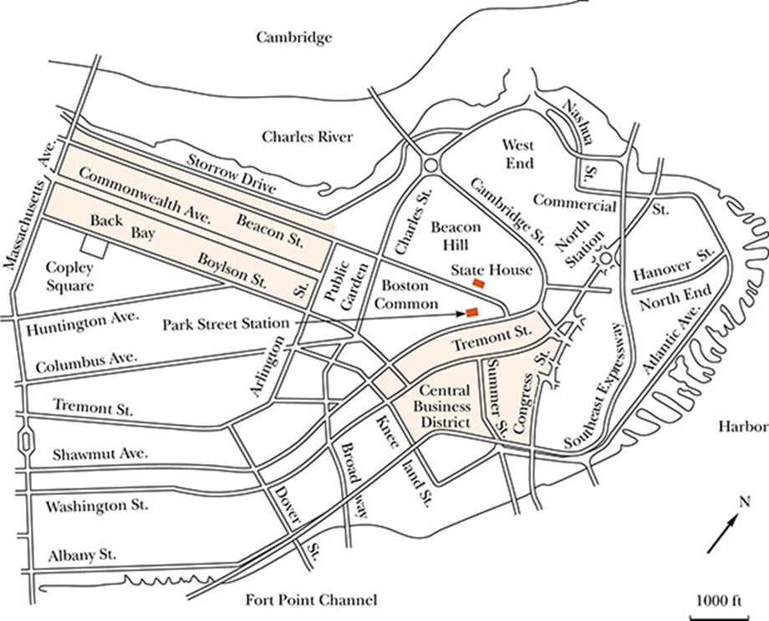
Downtown Boston
Notes:
Physical map
Dominant elements of city
Other physical elements identifiable with the location of the park

Slide 3
Kevin Lynch
Common Elements of Images
Paths—channels (streets, walkway, transit lines…) the traveler moves.
Edges---the boundaries buildings and open space (shores, walls….)
Districts---medium-to-large sections (“Back Bay”, “Beacon Hill”, “the Common”)
Nodes—points of intense activity (railroad terminal, square)
Landmarks---physical reference points (buildings, signs, stores, domes, gas station, or hills)

Slide 4
Kevin Lynch
Bostonians identified numerous paths, edges, nodes, districts, and landmarks.
In contrast, the resident of Jersey City could identify only a few such elements(no center, NYC skylines).
In LA, residents have an even less sharp image of their city because of sprawl and the uniformity of cross streets.

Slide 5
Stanley Milgram
How New Yorkers and Parisians understood their cities.
People construct mental maps based on their personal experience, their interests, and their knowledge of the socially recognized “important areas” of the city (“A Psychological Map of New York City”, Milgram, 1972).

Slide 6
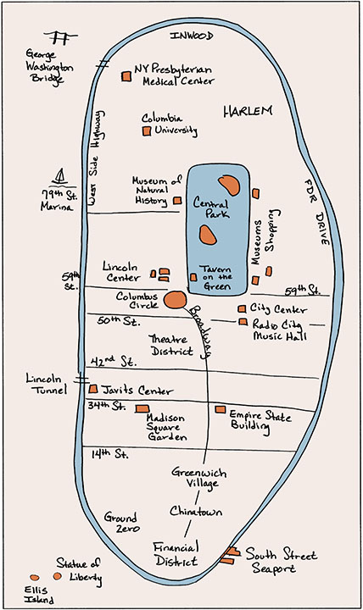
Mental Map of Manhattan(Beth’s Map)
Notes:
Highlights streets
Location of cultural centers
Midtown

Slide 7
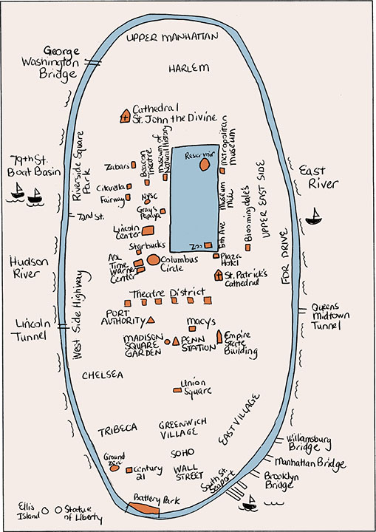
Mental Map of Manhattan(Cara’s Map)
Notes:
Emphasizes Upper West Side area
Parks, restaurants, high-rise buildings indicated
Streets not listed

Slide 8
Stanley Milgram
The Individuality of Mental Maps—Depending upon where they live, what they do, and how long they stayed in the city, people have a different comprehension of the city(with times, most people succeed in comprehending the city and using it effectively).
Multiple Urban Realities—social class, and race(community of which race) plays a key part in how residents understand the city.

Slide 9
Audiovisual materials
https://education.nationalgeographic.org/resource/finding-your-way/ (finding your way)
https://www.cnbc.com/2023/01/02/middle-class-income-in-major-us-cities.html. (young middle-class couple in Wyoming)

Slide 10
The Social Environment:Gesellschaft
How do we cope with city’s vast numbers and characteristic anonymity?
https://www.youtube.com/watch?v=IFjD3NMv6Kw&t=4s(7 principles for building better cities | Peter Calthorpe)
Erving Goffman (Relations in public1980)—city life is an orderly routine (go to work, dine, meet a friends…..) that allows people to meet their personal needs while surrounded by an unknown mass of others.

Slide 11
The Social Environment:Gesellschaft
Pedestrians observe an intricate set of social rules (traffic codes) 1) aware obstacles 2) speed of people 3) to move faster or slower, outside of lanes 4) avoid collision 5) scold one another
Escalators(on the right and left side)
Subway

Slide 12
A World of Strangers
Lyn Lofland(1985)---we live in “ a world of strangers.”, look for visual clues.
We identify strangers in terms of their appearance and their physical location within the city (reliance on appearance and location become essential).
Clothes in modern industrial societies are not as much important social as pre-industrial societies.

Slide 13
A World of Strangers
Location means more(business, residence, and entertainment).
Near Symphony Hall in Boston—on the one side, black-tie dress and on the other side, tattered clothes.
Lofland suggest that we can transform public space into private or semiprivate space ( a tavern Cheers, benches, stairways).

Slide 14
The City as Gesellschaft
Sheer physical size, large population, its anonymity(Gesellschaft)
But we cope
By creating our personal mental image of the city.
By observing codes of behaviors.
Seeking out clues to the identity of strangers.

Slide 15
Class, Race, and the Urban Experience
Mama’s dream In America from Norway in San Francisco.
The Marginal man (slowing the symptoms of fright).—living alone, with few friends and no local family.
Clara Rodriguez—growing up in a stable community (but the poorest of the poor) in South Bronx.
African American in ghetto—dream and reality (the witness of robbery).

Slide 16
The Social Environment: Gemeinshaft
Urban networks—Spillius(1972) found out that working-class couples in London maintain their own network (leisure time separately) while middle-class spouses have a shared network.
Washington, D.C. Street-Corner Men—Tally’s Corner in D.C.
Boston Neighborhoods(West End)—H. Gans(1982) found that low-income Italian, Jews, Poles, and Irish neighbors have strong ties with family, neighbors, and friends.

Slide 17
The Social Environment: Gemeinshaft
Friendship network by phone, cell phone, e-mail, Facebook, and Twitter.
Place invented to get together (John Irwin, 1977), socialize, meet, and enjoy themselves is called scenes (bars, clubs, discos, Bryant Park in NYC).
1) Lifestyles scenes (diverse people) 2) local scenes (exclusive) 3) open scenes (bars without specific clientele) 4) specialized scenes (club, tennis, chess….)

Slide 18
The texture of the city
Gerald Suttles (1984)—”texture(soul, personality)” NYC is the “Big Apple”, a city of energy, hustle, and fear. Boston—relaxed and cultural. LA—”laid back.”
Texture is grounded in its history, architecture, street names, even nick name (Hollywood).
Detroit—1970 (the flight of affluent people), dangerous. cultural renaissance(opera house, museum) and automated train system (the People Mover).

Slide 19
Humanizing the City
Virginia Schein (1995) conducted in-depth interviews with 30 single mothers receiving public assistance. A network of family, friends, and teachers provided both emotional support and resources( family, friends, church)
Carol Stack (1997)—Poor African American in inner-city area of Midwestern city maintain a stable community and meet their basic needs by constructing a diffuse family structure(cooperation and mutual support). “all our kin.”

